Slide 1




Azfahsyaz Fahmi Business Intelligence
Assessment Test
Tableau Public - Assesemnt Azfahsyaz

Slide 2


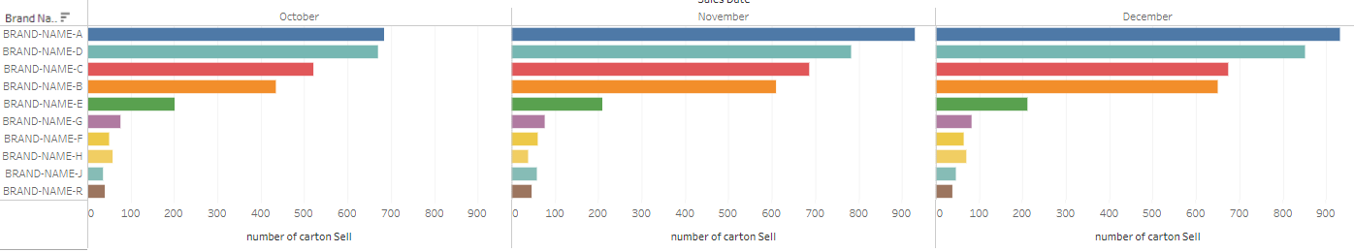
Top 10 Highest Carton Sell by Brands
TOP 10 Highest Carton Sell by Brands
16,074
16,512
2023
The trends for 3 months comparison was the top 5 of the brands maintain highest throughout the months. This indicated the success of the brand that we can maintain as top selling brands in our company.
Findings; Bottom 5 of the trends are changing; we can identify what was the reasons for the instability of the total numbers of carton sold.
Armed with insights into the top-performing brands, the marketing team can optimize their marketing campaigns to capitalize on existing consumer demand. They can allocate resources towards promoting high-performing brands and products, refine messaging and targeting strategies, and identify new opportunities for marketing initiatives.
Annual Report 2023
5

Slide 3
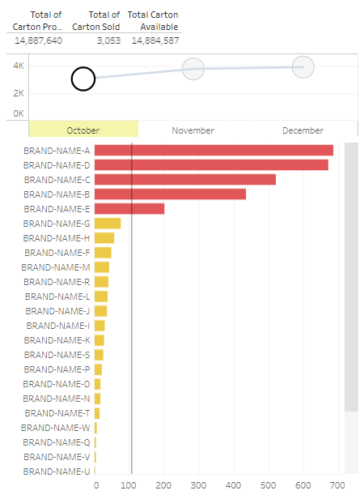
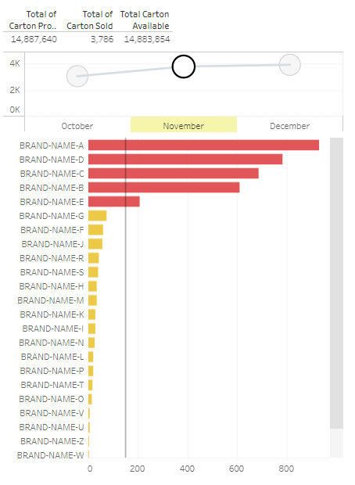
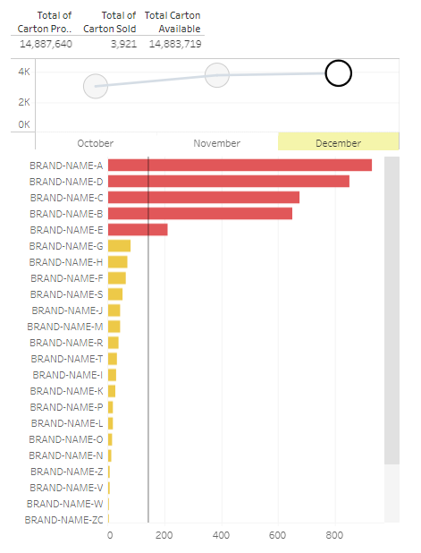



Group Revenue by Channels
OCT
NOV
DEC
The trends for 3 months comparison was the top 5 of the brands maintain highest throughout the months. This indicated the success of the brand that we can maintain as top selling brands in our company.
Findings; Bottom 5 of the trends are changing; we can identify what was the reasons for the instability of the total numbers of carton sold.
Armed with insights into the top-performing brands, the marketing team can optimize their marketing campaigns to capitalize on existing consumer demand. They can allocate resources towards promoting high-performing brands and products, refine messaging and targeting strategies, and identify new opportunities for marketing initiatives.
12.6% organic growth in E-commerce in 2023
Vinda brand being double 11 top sales tissue brand for eleven consecutive year¹
Annual Report 2023
6

Slide 4
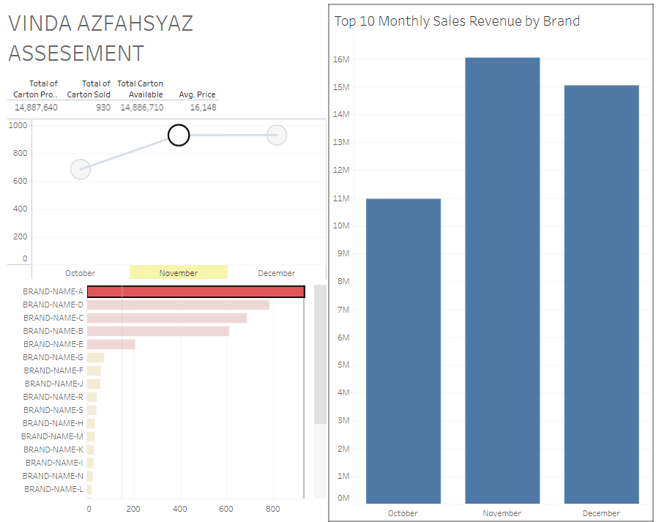
Group Revenue by Channels
Brand A has the highest during Nov, to be taken into consideration. Did Brand A have any activation or promotion during Nov? The total carton sold in NOV for Brand A has the highest in sales revenue.
We can use this data to maintain the sales revenue for Brand A, marketing can use this insight to maintain the sales revenue for brand A.
12.6% organic growth in E-commerce in 2023
Vinda brand being double 11 top sales tissue brand for eleven consecutive year¹
Annual Report 2023
6

Slide 5
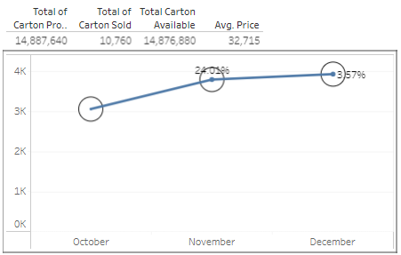


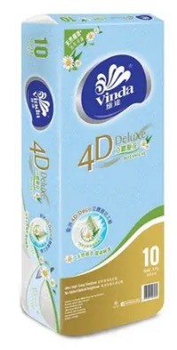
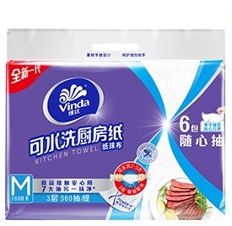
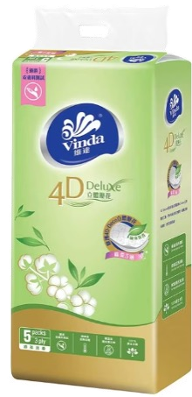
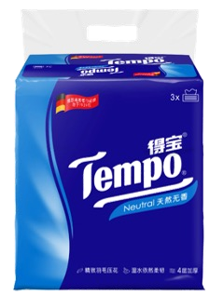
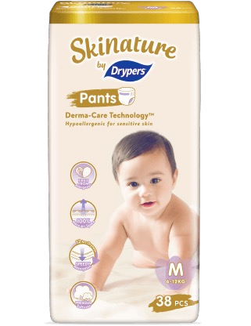
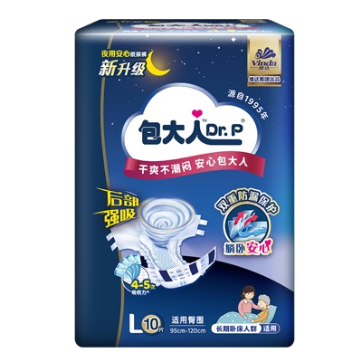
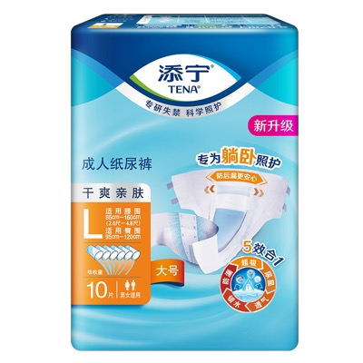

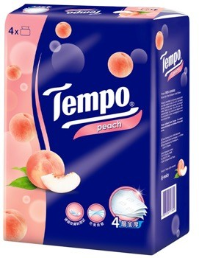
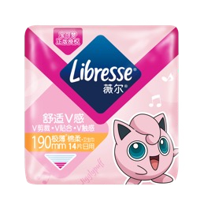
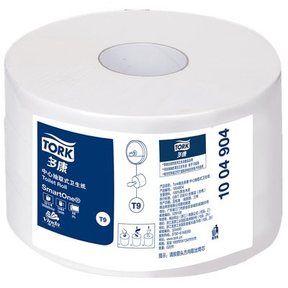
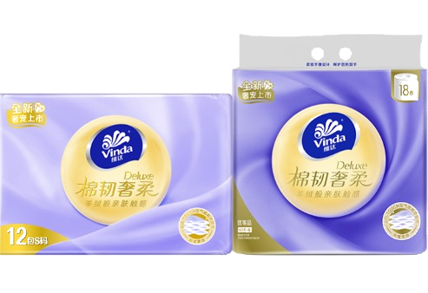
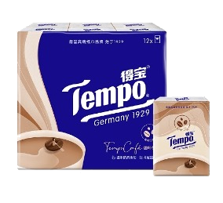
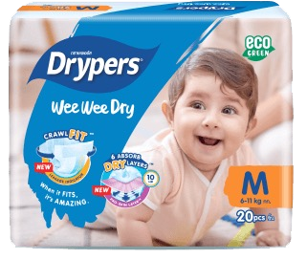
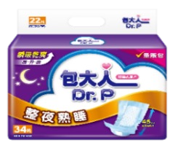
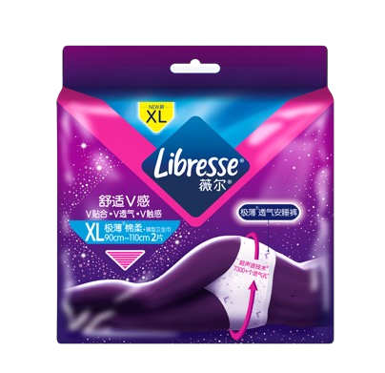
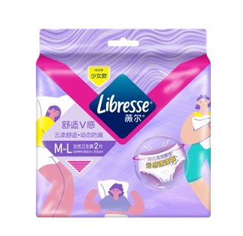
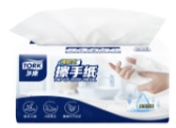
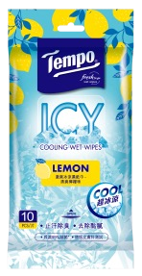
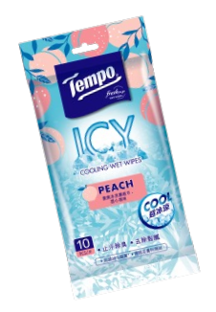
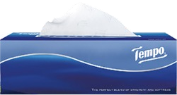
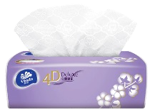
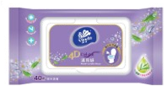

Oct,Nov and Dec Comparison
Growth in November and December from October
TOP 5 Brand that contribute highest in Sales Revenue and selling above average
Marketing Team can make use of this
1 YoY growth at constant exchange rates
Annual Report 2023
3

Slide 6
Thank you!

